Slide 1
Twitter Sentiment Classification:
apple vs google Products
Phase 4

Slide 2
group 6
members
- Viola Kimitei
-Paul Otuoro
-Charles Owiti
-Makena Odongo

Slide 3

The problem
Can we predict whether a tweet expresses positive, neutral, or negative sentiment about Apple or Google products?
Why it matters
Tweets are a concise, informal and sentiment-rich that help us understand customer satisfaction and public opinion.

Slide 4

What we did
1
Collected labelled tweets from 9000+ tweets
2
Cleaned and preprocessed text using python language
3
Used ML to predict sentiment

Slide 5

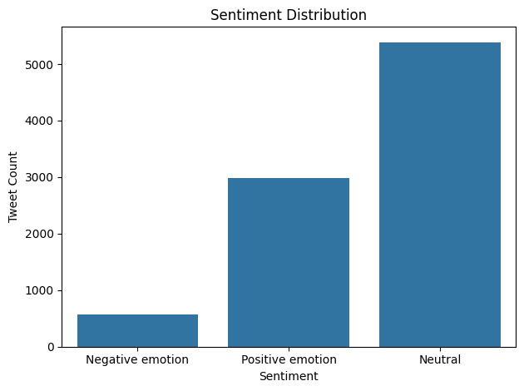
DATA insight

Slide 6
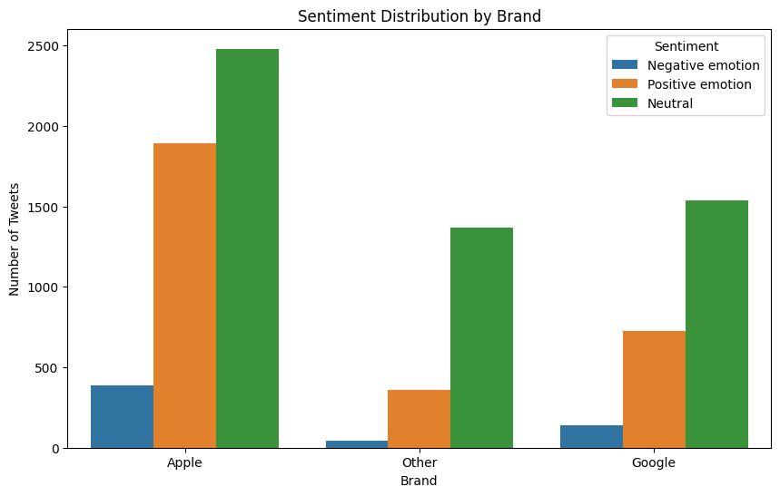
DATA Insight

Slide 7

modelling
 | accuracy | F1 score | strengths | Limitations
Logistic regression | 68% | 66% | Simple, interpretable, robust results | Slight confusion between neutral/neg
Naive bayes | 68% | 65% | Fast, work well with sparse data | Struggles with nuanced sentiment
Random forest | 68% | 65% | Captures complex patterns | Less interpretable, slower
Neural networks | 65% | 64% | Promising baseline with flexibility | Needs tuning, overfits easily

Slide 8

68%
BEST MODEL: Logistic regression

Slide 9

Challenges
1.
Tweets often have sarcasm, slang or ambiguous tone
2.
Neutral vs. Negative often get confused

Slide 10

Recommendations
1
Integrate this with real-time monitoring
2
Try transformer-based models
3
Use sentiment data to inform marketing/customer service

Slide 11

Thank You / q & A

